Slide 1
Monthly Sales Report

Slide 2
Key Takeaways
Total Sales by Region: The South region had the highest total sales (£358,951), followed by the West (£334,677).
Top Products: The highest-selling products by units sold were Jeans (6,507 units), Coats (5,601 units), and T-shirts (4,421 units).
Top Salespeople: The best-performing salespeople were John (£267,374), Freddie (£237,578), and Rob (£224,595).
Revenue Trends: January had the highest total sales (£494,979), followed by March (£390,254), with a decline in February (£351,989).

Slide 3
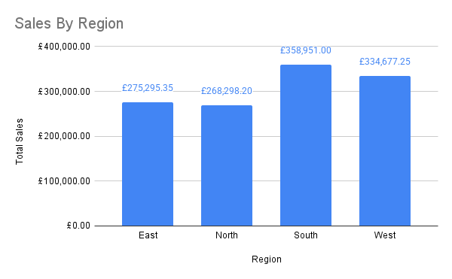
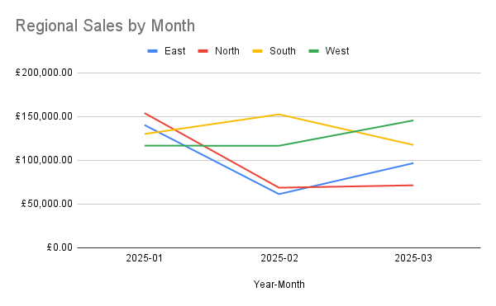
Regional Breakdown
The South region performed the best, followed by the West region, while the North and East regions lagged behind.
South (Yellow Line): Sales peaked in February but declined in March, ending lower than in January.
East (Blue Line): Experienced a sharp decline in February, followed by a recovery in March.
West (Green Line): Sales remained steady in January and February, then grew in March.
North (Red Line): Had the lowest sales overall but showed a small increase from February to March.

Slide 4
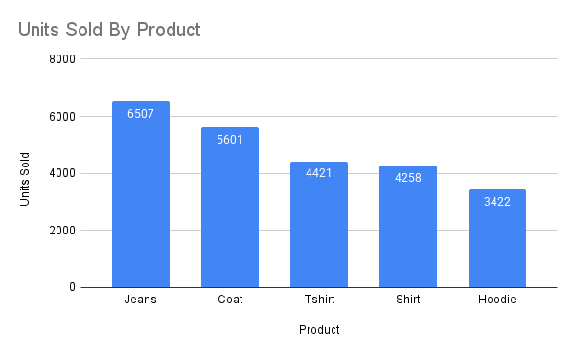
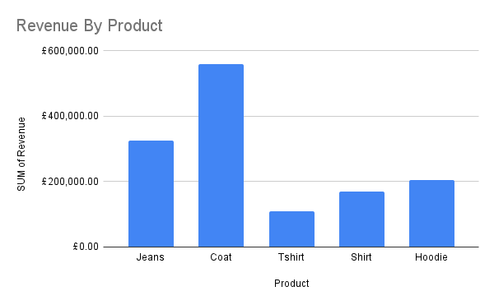
Product Breakdown
Jeans were the best-selling product, followed by Coats and T-shirts, indicating strong demand for casual apparel.
Despite,Jeans being the best selling product, Coats made the most revenue, we could looking into increasing Jean prices in order to make up this revenue.

Slide 5
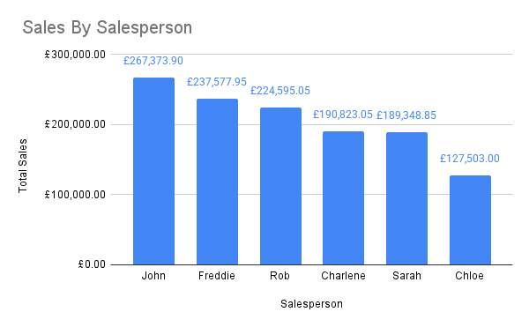
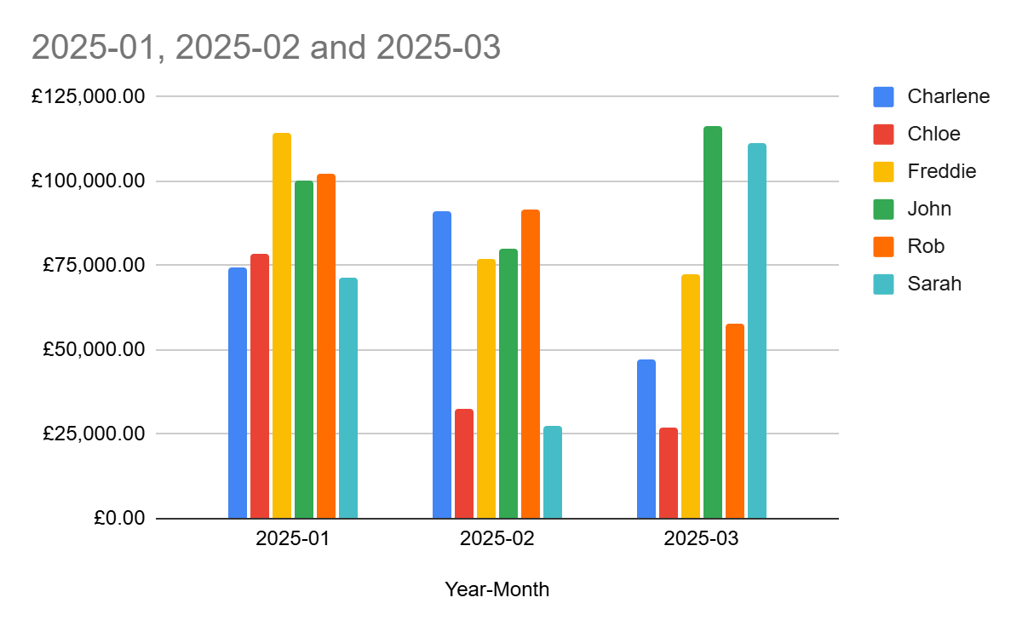
Breakdown By Salesperson
Top Performer: John led with the highest sales at £267,373.90, significantly outperforming others.
Strong Contributors: Freddie (£237,577.95) and Rob (£224,595.05) followed closely, making them the top 3 salespeople.
Lowest Performer: Chloe (£127,503.00) had the lowest total sales, nearly £140K less than John, indicating room for improvement.
Key Takeaway: There is a clear gap between top and bottom performers—potential training or strategy adjustments could help lower performers improve.
Freddie and John had the highest revenues in January (2025-01), both exceeding £100,000.
Sarah and John dominated in March (2025-03), reaching the highest revenue among all individuals.
Charlene performed consistently well in January and February but saw a decline in March.
Sarah and John are emerging as strong performers, indicating a potential strategy to leverage their strengths.
Freddie had a great start but needs a strategy to sustain performance in later months.
Chloe and Rob may need additional support or a performance boost strategy to improve their revenue contributions.

Slide 6
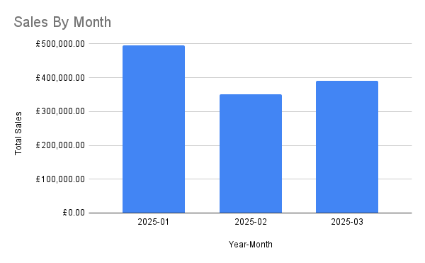
Revenue Trends Over Time
January had the highest revenue, while February saw a drop, followed by a partial recovery in March.

